Slide 1
Shortest Paths Algorithms
BFS
Dijkstra’s Algorithm
Bellman-Ford Algorithm
Lecture 5.1, Spring 2026
Notes:
Welcome to week 2
Finally, we get to build a routing protocol. Today will be entirely focused on Distance-Vector approach and then we’ll talk about an alternative approach hopefully tomorrow.
so we're going to number them 1 through seven we'll come up with rules and when you put the seven rules together you get
29:30
an algorithm called the distance Vector protocol and it allows us to find shortest paths through the entire
29:36
network

Slide 2
BFS
Dijkstra’s Algorithm
Bellman-Ford Algorithm

Slide 3
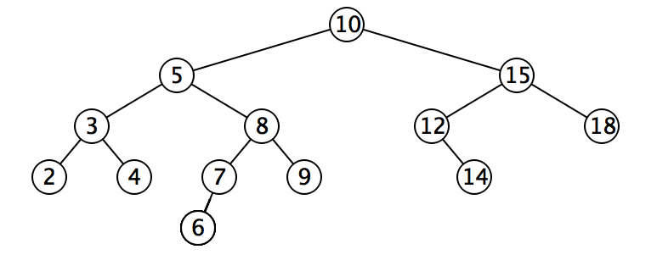
Review: Graph traversal w/ DFS
Depth First Search: go as far as you can down one path till you hit a dead end (no neighbors, or no unvisited neighbors). Once you hit a dead end, backtrack and try other edges that you have not tried yet
Analogy of wandering a maze – if you get stuck at a dead end, trace your steps backwards to the previous fork in the road, and try a different path
one valid DFS traversal: 10, 5, 3, 2, 4, 8, 7,6, 9, 15, 12, 14, 18
Notes:
(since you physically have to go and try it out to know it’s a dead end)

Slide 4
Review: Graph traversal w/ BFS
Breadth First Search - traverse level by level, and visit 1-hop neighbors before 2-hop neighbors before 3-hop neighbors…
Analogy: sound wave spreading from a starting point, going outwards in all directions; mold on a piece of food spreading outwards so that it eventually covers the whole surface
one valid BFS traversal: 10, 5, 15, 3, 8, 12, 18, 2, 4, 7, 9, 14, 6

Slide 5
BFS for (Unweighted) Shortest Path Problem
BFS can find shortest paths in an unweighted graph
BFS visits nodes in order of their distance from the source node, ensuring the first path found to any node is the shortest possible path in terms of the number of edges
Time complexity: O(V+E)
Advantages:
Optimal for unweighted graphs
Simple implementation
Limitations:
Only works for unweighted graphs
(Unweighted) Shortest Path Problem
Given source node s (start) and a target node t, how long is the shortest path from s to t? What edges makeup that path?
Notes:
Not suitable for graphs with negative edges

Slide 6
BFS for Shortest Paths in an Unweighted Graph
...
Map<Node, Edge> PN = ...
Map<Node, Double> SD = ...
PN.put(start, null);
SD.put(start, 0.0);
while (!perimeter.isEmpty()) {
Node from = perimeter.remove();
for (Edge edge : graph.edgesFrom(from)) {
Node to = edge.to();
if (!visited.contains(to)) {
PN.put(to, edge);
SD.put(to, SD.get(from) + 1);
perimeter.add(to);
visited.add(to);
}
}
}
return PN;
}
Keep track of how far each node is from the start with two maps
SD: Shortest Distance from source node
PN: Previous Node stores backpointers: each node remembers what node was used to arrive at it
PERIMETER
A
B
C
D
E
SD
2
E
VISITED
0
start
A
1
C
PN
1
B
2
D
Notes:
The start required no edge to arrive at, and is on level 0
Remember how we got to this point, and what layer this node is part of

Slide 7
Shortest Path Tree
SD
2
E
VISITED
0
The table of SD/PN encodes the Shortest Path Tree (SPT), which encodes the shortest path and distance from the start node to every other node
Shortest path to any node can be obtained from SPT
Length of shortest path from A to D?
Lookup in SD map: 2
What’s the shortest path from A to D?
Build the path backwards from PN: start at D, follow backpointer to B, follow backpointer to A – the shortest path is ABD
start
A
1
C
PN
1
B
2
D
Node | SD | PN
A | 0 | /
B | 1 | A
C | 1 | A
D | 2 | B or C
E | 2 | C
Depending on the order of visiting A’s successors with BFS: either B before C, or C before B, D’s PN may be either B or C
Notes:
A general concept: in this implementation, made up of distances and backpointers

Slide 8
BFS Time Complexity
Using Adjacency List: O(V + E)
Each node is processed exactly once: O(V)
Each edge is examined exactly once: O(E)
Total complexity: O(V + E)
Efficient for sparse graphs (where E is much less than V²)
Using Adjacency Matrix: O(V²)
For each node, we must check all possible edges to other vertices
This results in O(V²) operations regardless of the actual number of edges

Slide 9
BFS
Dijkstra’s Algorithm
Bellman-Ford Algorithm

Slide 10
Dijkstra’s Algorithm
Named after its inventor, Edsger W. Dijkstra (1930-2002)
1972 Turing Award
Solves the Shortest Path Problem on a weighted graph
start
A
14.0
C
target
12.0
1.5
B
D
9000.2
Notes:
Suppose we want to find shortest path from A to C, using weight of each edge as “distance”
The idea: reminiscent of BFS, but adapted to handle weights
Nodes not in the set will have a “best distance so far”

Slide 11

Edge Relaxation
Relax edge e = u→v with weight w(u,v). (We also write edge uv to denote u→v)
SD[u] is length of shortest known path from s to u.
SD[v] is length of shortest known path from s to v.
PN[v] is the previous node on shortest known path from s to v.
If e = u→v gives shorter path to v through u, update SD[v] and PN[v].
SD[v] = min(SD[v], SD[u] + w(u,v)); PN[v]=u
After relaxing edge uv, the shortest path from s to v is updated to go through node u, with cost of 4.4
private void relax(DirectedEdge e)
{
Int u = e.from(), v = e.to();
if (SD[v] > SD[u] + w(u,v))
{
SD[v] = SD[u] + w(u,v);
PN[v] = u;
}
}
PN[v]=u
3.1
u
1.3
s
v
7.2
OLD PN(v)=x, SD[v] = 7.2 > SD[u] + w(u,v) = 3.1+1.3 = 4.4
NEW SD[v] ← SD[u] + w(u,v) = 4.4, PN[v] = u
x
Previous shortest path from s to v goes through node x, with cost of 7.2
Notes:
Dijkstra’s Algorithm is greedy and optimal: any node that has been visited should have its shortest distance to the source.

Slide 12
Generic Shortest-paths Algorithm
Generic algorithm (to compute SPT from s)
For each node v: SD[v] = ∞.
For each node v: PN[v] = null.
SD[s] = 0.
Repeat until done:
- Relax any edge.
Proposition. Generic algorithm computes SPT (if it exists) from s.
Proof.
Throughout algorithm, SD[v] is the length of a simple path from s to v (and PN[v] is its previous node on the path).
Each successful relaxation decreases SD[v] for some v.
The entry SD[v] can decrease at most a finite number of times.
Efficient implementations. How to choose which edge to relax?
Ex 1. Dijkstra’s algorithm. (no negative weights)
Ex 2. Topological sort. (DAG with no directed cycles)
Ex 3. Bellman–Ford algorithm. (negative weights, can detect negative cycles)
Notes:
Ex 2. Topological sort algorithm. (no directed cycles).

Slide 13
Dijkstra's Algorithm
Initialization:
Set the distance to the source node as 0 and to all other nodes as infinity.
Mark all nodes as unvisited and store them in a priority queue.
Main Loop:
Visit the unvisited node u with the shortest known distance (minimum SD) from the queue.
For each unvisited neighbor node v of node u, calculate its tentative distance through the current node. If this distance is smaller than the previously recorded distance, update it with edge relaxation for edge uv.
Mark the current node as visited once all its neighbors are processed.
Termination:
The algorithm continues until all reachable nodes are visited.
Notes:
Greedy and optimal algorithm: any node that has been visited should have its shortest distance to the source.
It works for both undirected and directed graphs. The only difference is how to get neighbors of node v, as each undirected edge is treated as two directed edges in both directions.
Notes:
which follows the edge arrow direction for directed graphs

Slide 14
Dijkstra’s Algorithm: Idea
PERIMETER
2
4??
UNKNOWN
0
2
2
3
∞
start
A
B
F
H
1
4
5
10
2
∞
1
9
1
3
G
4
2
C
KNOWN
D
11
1
E
7
12??
Initialization:
Start node has distance 0; all other nodes have distance ∞
At each step:
Pick the closest unknown node v (with smallest SD)
Add it to the “cloud” of known nodes (set of nodes whose shortest distance has been computed)
Update “best-so-far” distances for nodes with edges from v

Slide 15
Dijkstra’s Pseudocode (High-Level)
0
KNOWN
start
A
2
2
PERIMETER
B
5
Suppose we already visited B, SD[D] = 7
Now considering edge (C, D):
oldDist = 7
newDist = 3 + 1
Relaxation updates SD[D], PN[D]
3
3
7??
Similar to “visited” in BFS, “known” is set of nodes that have been visited and we know shortest paths to them
C
u
1
v
D
dijkstraShortestPath(G graph, V start)
Set known; Map PN, SD;
Init all paths to infinite.
initialize SD with all nodes mapped to ∞, except start to 0
while (there are unknown nodes):
let u be the closest unknown node
known.add(u);
Greedy algo: visit closest node first
for each edge (u,v) from u with weight w:
oldDist = SD.get(v) // previous best path to v
newDist = SD.get(u) + w // what if we went through u?
Consider all nodes reachable from the newly-added node u: would getting there through u be a shorter path than their current path length?
if (newDist < oldDist):
SD.put(v, newDist)
PN.put(v, u)
Notes:
Dijkstra’s algorithm is all about updating “best-so-far” in SD if we find shorter path!

Slide 16
Dijkstra’s Algorithm: Key Properties
Once a node is visited (marked known), its shortest path is known. Can reconstruct path by following back-pointers (in PN map)
dijkstraShortestPath(G graph, V start)
Set known; Map PN, SD;
initialize SD with all nodes mapped to ∞, except start to 0
while (there are unknown nodes):
let u be the closest unknown node
known.add(u)
for each edge (u,v) to unknown v with weight w:
oldDist = SD.get(v) // previous best path to v
newDist = SD.get(u) + w // what if we went through u?
if (newDist < oldDist):
SD.put(v, newDist)
PN.put(v, u)
While a node is not yet visited/known, another shorter path might be found. We call this update relaxing the distance because it only ever shortens the current best path
If we only need path to a specific node, can stop early once that node is visited, and return a partial shortest path tree
Notes:
Once a node is marked known, its shortest path is known
Can reconstruct path by following backpointers
While a node is not known, another shorter path might be found
The order in which nodes are added to the known set is unimportant
If we only need path to a specific node, can stop early once that node is known
Because its shortest path cannot change
Return a partial shortest path tree
It is not possible to find a shorter path that uses a farther node we’ll consider later

Slide 17
Dijkstra’s Algorithm: Runtime
dijkstraShortestPath(G graph, V start)
Set known; Map PN, SD;
initialize SD with all nodes mapped to ∞, except start to 0
while (there are unknown nodes):
let u be the closest unknown node
known.add(u)
for each edge (u,v) to unknown v with weight w:
oldDist = SD.get(v) // previous best path to v
newDist = SD.get(u) + w // what if we went through u?
if (newDist < oldDist):
SD.put(v, newDist)
PN.put(v, u)
update distance in list of unknown nodes
O(V)
O(V)
O(log V) using binary min-heap implementation of a priority queue
O(E)
O(log V)
Initialization: O(V)
Extracting nodes: O(V log V)
Edge relaxations: O(E log V)
Total runtime: O((V+E) log V)
Notes:
We can use an optimized structure that will tell us the “minimum” distance node, and let us “update distance” as we go… Use a HeapMinPriorityQueue! (like the one from P3)

Slide 18
Greedy Algorithms
A greedy algorithm makes the locally optimal choice at each step
Dijkstra’s is “greedy” because once a node is marked as visited, it is never revisited
This is why Dijkstra’s does not work with negative edge weights
In the lecture and exams, when there are multiple possible orders of visiting the next node (with equal SD value), select the next node in alphabetical or numerical order
The intermediate steps will depend on the order, but final result will be the same
Other examples of greedy algorithms are:
Kruskal and Prim’s minimum spanning tree algorithms
Notes:
“When there are multiple possible orders of visiting the next node, select the next node in alphabetical or numerical order.”
Dijkstra’s is “greedy” because once a node is marked as visited, it is never revisited
This is why Dijkstra’s does not work with negative edge weights
Huffman compression

Slide 19
Resolving Ambiguities
As There are typically multiple possible orders of the same graph. In the lecture and exams, we often use the following rule to resolve any ambiguities:
“When there are multiple possible orders of visiting the next node, select the next node in alphabetical or numerical order.”

Slide 20
Example I
0
2
∞
∞
∞
start
B
2
3
A
F
H
1
4
5
10
2
∞
1
9
∞
3
G
∞
2
C
11
∞
D
1
Node | SD | PN
A | 0 | /
B | ∞
C | ∞
D | ∞
E | ∞
F | ∞
G | ∞
H | ∞
E
7
Visit Order
Start from the source node A

Slide 21
Example I
0
2
2??
∞
∞
?? Means that SDs have not yet been finalized, as a shortcut may be found in the future.
start
B
2
3
A
F
H
1
4
5
10
2
∞
1
9
1??
3
G
4??
2
C
11
∞
D
1
Node | SD | PN
A | 0 | /
B | 2 | A
C | 1 | A
D | 4 | A
E | ∞
F | ∞
G | ∞
H | ∞
E
7
Visit Order
A
Visit C next, since C has the smallest SD of 1 among all unknown (unvisited) nodes

Slide 22
Example I
0
2
2??
∞
∞
start
B
2
3
A
F
H
1
4
5
10
2
∞
1
9
1
3
G
4??
2
C
11
12??
D
1
Node | SD | PN
A | 0 | /
B | 2 | A
C | 1 | A
D | 4 | A
E | 12 | C
F | ∞
G | ∞
H | ∞
E
7
Visit Order
A, C
Visit B next, since B has the smallest SD of 2 among all unvisited nodesc
Notes:
Note how E’s distance is 12 (path length) instead of 11 (edge weight)

Slide 23
Example I
0
2
2
4??
∞
start
B
2
3
A
F
H
1
4
5
10
2
∞
1
9
1
3
G
4??
2
C
11
12??
D
1
Node | SD | PN
A | 0 | /
B | 2 | A
C | 1 | A
D | 4 | A
E | 12 | C
F | 4 | B
G | ∞
H | ∞
E
7
Visit Order
A, C, B
We can choose to visit either D or F next, since they have equal smallest SD of 4 among all unvisited nodes. Let’s visit D in alphabetical order
Notes:
Note how
Again, we don’t set F’s pathlen to 2 (the edge weight); we set it to 4 (length of A->B->F)
We don’t update C with distance 7 (A->B->C); its optimal path is already known
We don’t update E with distance 12 (A->B->E); the path length is the same

Slide 24
Example I
0
2
2
4??
∞
start
B
2
3
A
F
H
1
4
5
10
2
∞
1
9
1
3
G
4
2
C
11
12??
D
1
Node | SD | PN
A | 0 | /
B | 2 | A
C | 1 | A
D | 4 | A
E | 12 | C
F | 4 | B
G | ∞
H | ∞
E
7
Visit Order
A, C, B, D
Visit F next, since F has the smallest SD of 4 among all unvisited nodes
Notes:
Nothing was updated; we already had an optimal path to C

Slide 25
Example I
0
2
2
4
7??
start
B
2
3
A
F
H
1
4
5
10
2
∞
1
9
1
3
G
4
2
C
11
12??
D
1
Node | SD | PN
A | 0 | /
B | 2 | A
C | 1 | A
D | 4 | A
E | 12 | C
F | 4 | B
G | ∞
H | 7 | F
E
7
Visit Order
A, C, B, D, F
Visit H next, since H has the smallest SD of 7 among all unvisited nodes

Slide 26
Example I
0
2
2
4
7
start
B
2
3
A
F
H
1
4
5
10
2
8??
1
9
1
3
G
4
2
C
11
12??
D
1
Node | SD | PN
A | 0 | /
B | 2 | A
C | 1 | A
D | 4 | A
E | 12 | C
F | 4 | B
G | 8 | H
H | 7 | F
E
7
Visit Order
A, C, B, D, F, H
Visit G next, since G has the smallest SD of 8 among all unvisited nodes
Notes:
OLD SD[F] = $∞$ > SD[D] + w(D,F) = 7+2 = 9
NEW SD[F] ← SD[D] + w(D,F) = 9, PN[F] = D

Slide 27
Example I
0
2
2
4
7
start
B
2
3
A
F
H
1
4
5
10
2
8
1
9
1
3
G
4
2
C
11
11??
D
1
Node | SD | PN
A | 0 | /
B | 2 | A
C | 1 | A
D | 4 | A
E | 12 11 | C G
F | 4 | B
G | 8 | H
H | 7 | F
E
7
Visit Order
A, C, B, D, F, H, G
We found a shortcut to E going through G, so we update SD and PN for E. Visit E next, since it is the last unvisited node
Notes:
Note how we found a better path to E at last (A->B->F->H->G->E), with cost 11; formerly path A->C->E had cost 12

Slide 28
Example I Final
0
2
2
4
7
start
B
2
3
A
F
H
1
4
5
10
2
8
1
9
1
3
G
4
2
C
11
11
Node | SD | PN
A | 0 | /
B | 2 | A
C | 1 | A
D | 4 | A
E | 12 11 | C G
F | 4 | B
G | 7 8 | 8 H
H | 7 | F
D
1
E
7
Visit Order
A, C, B, D, F, H, G, E
All nodes have now been visited and are known
Notes:
The table now contains the SD (shortest distance) to each node N from the source node A, and its PN (previous node) in the shortest path. The table of SD/PN encodes the Shortest Path Tree (SPT)

Slide 29
Example I: Interpreting the Results
0
2
2
4
7
How to get the shortest path from A to E?
Follow PN backpointers to get path ABFHGE
start
B
2
3
A
F
H
1
4
5
10
2
8
1
9
1
3
G
4
2
C
11
11
Node | SD | PN
A | 0 | /
B | 2 | A
C | 1 | A
D | 4 | A
E | 11 | G
F | 4 | B
G | 8 | H
H | 7 | F
D
1
E
7
Visit Order
A, C, B, D, F, H, G, E
Notes:
Walk through the chain of “previous” (E->G->H->F->B->A)

Slide 30
Example I Sample Exam Question and Answer
Given this directed graph, run Dijkstra’s Algo to find shortest paths starting from source node A. Give the node visit order, and fill in this table of SN (Shortest Distance) and PN (Previous Node), crossing out old SD and PN as you find a shortcut path with smaller SD
Visit Order
A, C, B, D, F, H, G, E
Node | SD | PN
A | 0 | /
B | 2 | A
C | 1 | A
D | 4 | A
E | 12 11 | C G
F | 4 | B
G | 7 8 | 8 H
H | 7 | F
2
2
3
start
A
B
F
H
1
4
5
10
2
1
9
3
G
2
C
11
D
1
E
7
Notes:
At exam time, you will be given a graph with a start node (A), and required to fill in this table, crossing out old items as you find a shortcut path

Slide 31
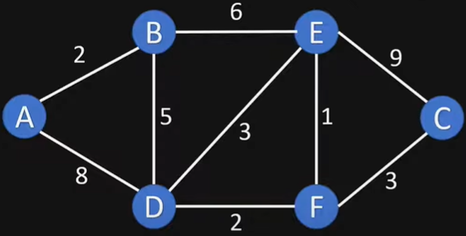
Example II
Dijkstras Shortest Path Algorithm Explained | With Example | Graph Theory
https://www.youtube.com/watch?v=bZkzH5x0SKU

Slide 32
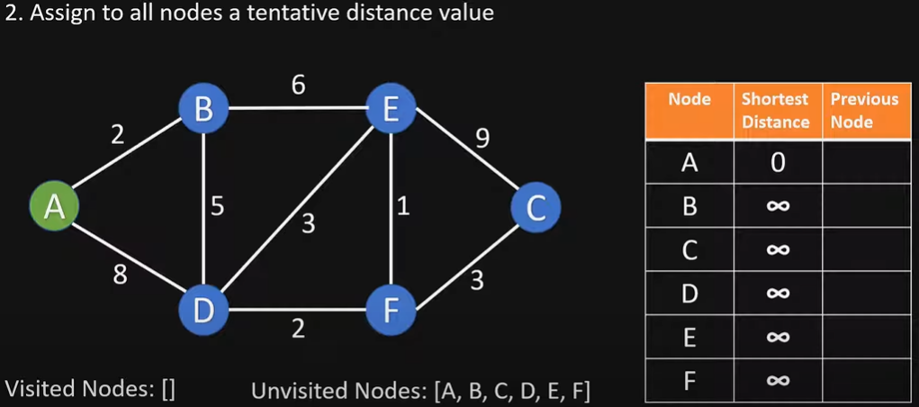
Initialize

Slide 33
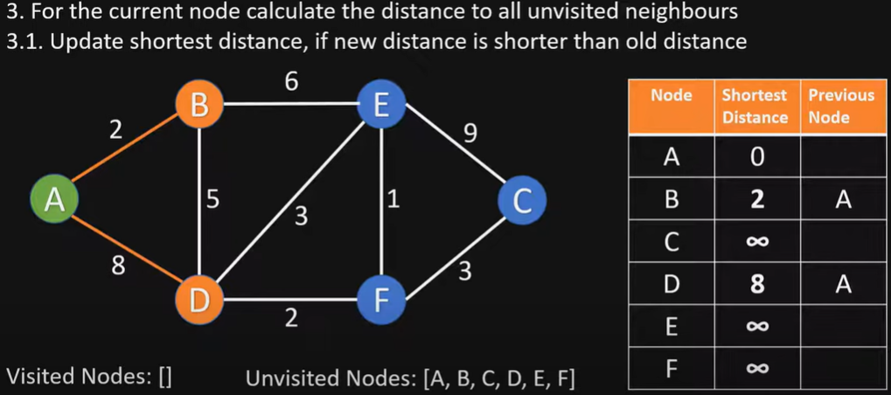
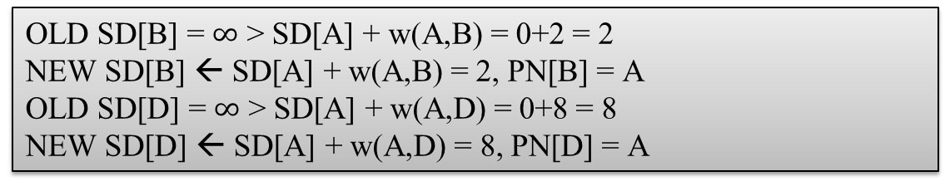
Visit node A
OLD SD[B] = $∞$ > SD[A] + w(A,B) = 0+2 = 2
NEW SD[B] ← SD[A] + w(A,B) = 2, PN[B] = A
OLD SD[D] = $∞$ > SD[A] + w(A,D) = 0+8 = 8
NEW SD[D] ← SD[A] + w(A,D) = 8, PN[D] = A

Slide 34
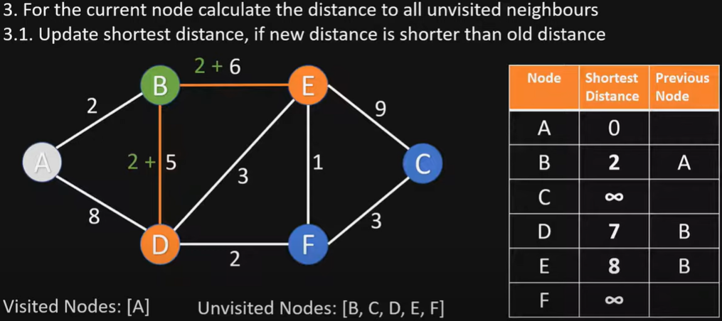
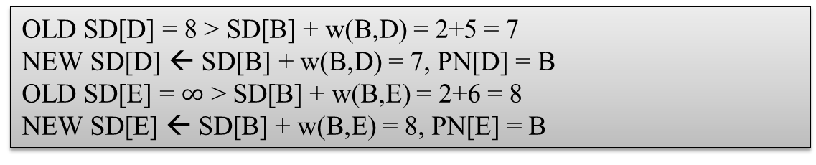
Visit node B
OLD SD[D] = 8 > SD[B] + w(B,D) = 2+5 = 7
NEW SD[D] ← SD[B] + w(B,D) = 7, PN[D] = B
OLD SD[E] = $∞$ > SD[B] + w(B,E) = 2+6 = 8
NEW SD[E] ← SD[B] + w(B,E) = 8, PN[E] = B

Slide 35
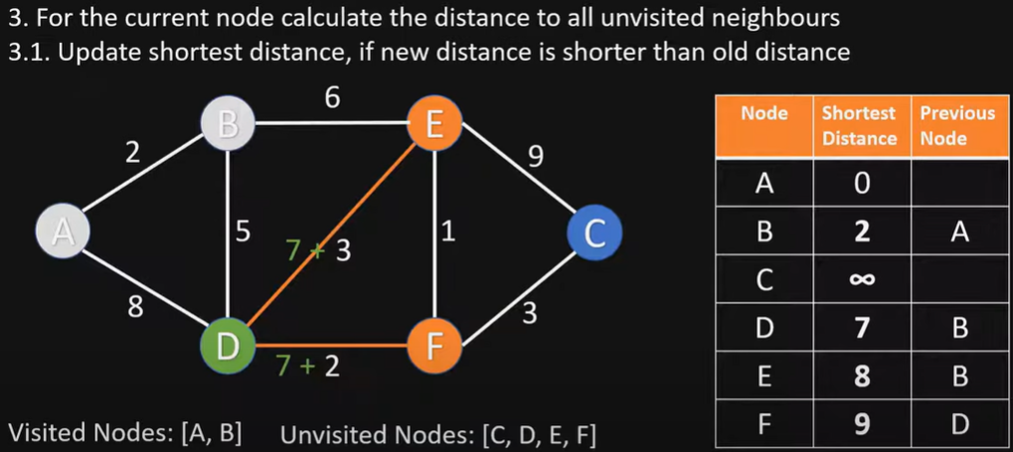
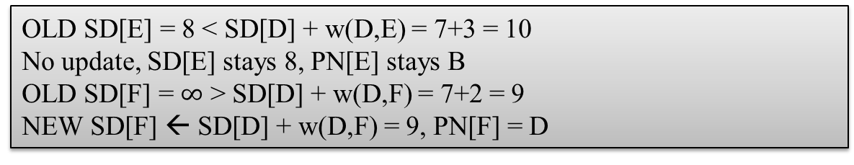
Visit node D
OLD SD[E] = 8 < SD[D] + w(D,E) = 7+3 = 10
No update, SD[E] stays 8, PN[E] stays B
OLD SD[F] = $∞$ > SD[D] + w(D,F) = 7+2 = 9
NEW SD[F] ← SD[D] + w(D,F) = 9, PN[F] = D

Slide 36
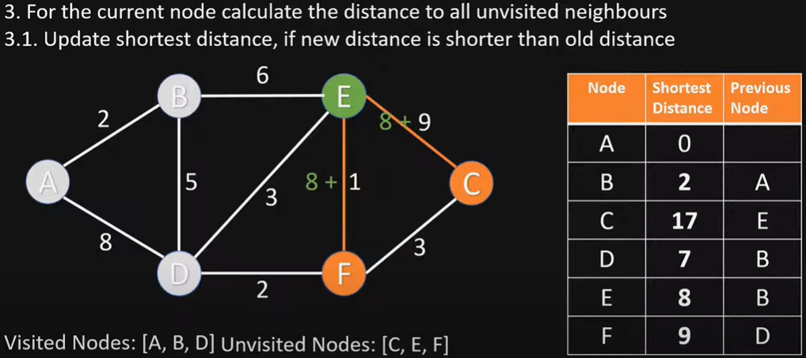
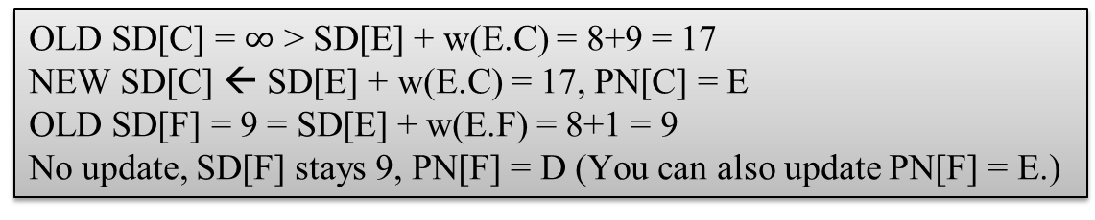
Visit node E
OLD SD[C] = $∞$ > SD[E] + w(E.C) = 8+9 = 17
NEW SD[C] ← SD[E] + w(E.C) = 17, PN[C] = E
OLD SD[F] = 9 = SD[E] + w(E.F) = 8+1 = 9
No update, SD[F] stays 9, PN[F] = D (You can also update PN[F] = E.)

Slide 37
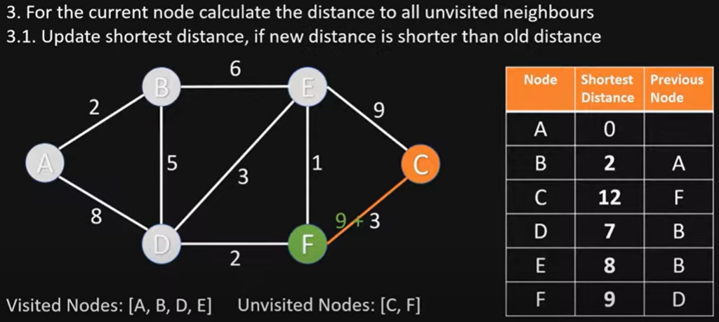
Visit node F
OLD SD[C] = 17 > SD[F] + w(F,C) = 9+3 = 12
NEW SD[C] ← SD[F] + w(F,C) = 12, PN[C] = F

Slide 38
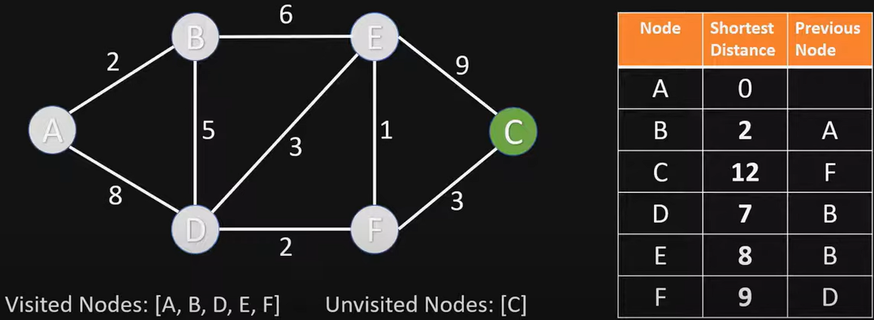
Visit node C
Nothing changes, since C has no unvisited neighbor nodes

Slide 39
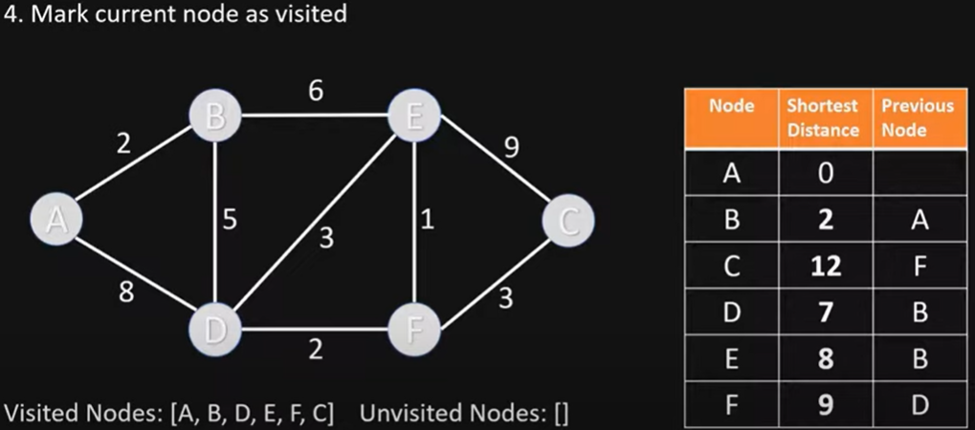
End of Algorithm
The table now contains the SD (shortest distance) to each node N from the source node A, and its PN (previous node) in the shortest path

Slide 40
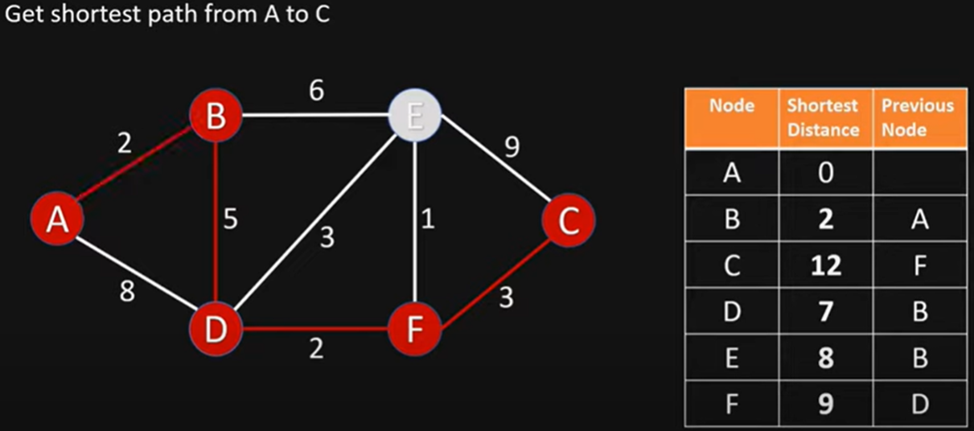
Getting the Shortest Path from A to C
C’s previous node is F; F’s previous node is D; D’s previous node is B; B’s previous node is A
Shortest Path from A to C is ABDFC

Slide 41
Example II Exam Question and Answer
Given this directed graph, run Dijkstra’s Algo to find shortest paths starting from source node A. Give the node visit order, and fill in this table of SN (Shortest Distance) and PN (Previous Node), crossing out old SD and PN as you find a shortcut path with smaller SD
Visit Order
A, B, D, E, F, C
Node | SD | PN
A | 0 | /
B | 2 | A
C | 17 12 | E F
D | 8 7 | A B
E | 8 | B
F | 9 | D
Notes:
At exam time, you will be given a graph with a start node (A), and required to fill in this table, crossing out old items as you find a shortcut path

Slide 42

choose node 5
relax all edges adjacent from 5
choose node 2
relax all edges adjacent from 2
choose node 3
relax all edges adjacent from 3
choose node 6
relax all edges adjacent from 6
Example III
Final Answer
1
v SD
Visit Order
0, 1, 7, 4, 5, 2, 3, 6
15
3
$$∞$$
$∞$ $∞$
$$∞$$
$$∞$$
$$∞$$
$$∞$$
$$∞$$
0
5
17
20
9
14
29
8
15
17
13
26
14
25
0
1
2
3
4
5
6
7
5
4
12
0
3
Node | SD | PN
0 | 0 | /
1 | 5 | 0
2 | 17 15 14 | 1 7 5
3 | 20 17 | 1 2
4 | 9 | 0
5 | 14 13 | 7 4
6 | 29 26 25 | 4 5 2
7 | 8 | 0
8
7
2
7
9
9
5
6
1
5
11
v PN
4
4
13
6
0
1
2
3
4
5
6
7
-
-
-
-
-
-
-
-
0
1
1
0
7
4
0
7
2
4
5
5
2
20
choose source node 0
relax all edges adjacent from 0
choose node 1
relax all edges adjacent from 1
choose node 7
relax all edges adjacent from 7
choose node 4
relax all edges adjacent from 4
42
Notes:
Consider nodes in increasing order of distance from s
(non-tree node with the lowest SD[ ] value).
Add node to tree and relax all edges pointing from that node.

Slide 43
BFS
Dijkstra’s Algorithm
Bellman-Ford Algorithm

Slide 44
Bellman-Ford Algorithm
A shortest path algorithm that works with negative edge weights
There can be at most V - 1 edges in our shortest path
If there are V or more edges in a path that means there’s a cycle/repeated node
Run V - 1 iterations of shortest path analysis through the graph
Repeatedly revisit and update SD and PN
Look at each vertex’s outgoing edges in each iteration
It is slower than Dijkstra’s because it will revisit previously assessed nodes
Can terminate early when all SD values have converged
Time complexity:
Worst Case: O(VE); Average Case: O(VE)
If the graph is dense or complete, the value of E becomes O(V²). So overall time complexity becomes O(V³)
Bellman-Ford, by Michael Sambol
https://www.youtube.com/watch?v=9PHkk0UavIM
https://www.youtube.com/watch?v=obWXjtg0L64
Bellman–Ford Algorithm
For each node v: SD [v] = ∞.
For each node v: PN[v] = null.
SD [s] = 0.
For i = 1 to V−1:
For each vertex:
Relax all its outgoing edges
(Or equivalently
Relax all edges)
In each iteration, we relax every edge once. The order of relaxation may affect how quickly distances converge, but it does not affect correctness, and the final solution is guaranteed to be optimal.
Notes:
https://www.youtube.com/watch?v=9PHkk0UavIM
Relax all edges V-1 times.
The order of edge relaxations affects algorithm efficiency but not correctness
There are two equivalent ways to describe Bellman–Ford:
Version 1 (Edge List Form — textbook standard)
For i = 1 to V−1:
For each edge in E:
Relax
Version 2 (Node-based relaxation)
For i = 1 to V−1:
For each vertex:
Relax all outgoing edges
These are equivalent as long as every edge is relaxed once per iteration.
Order only affects how fast values propagate within that iteration — not final correctness.

Slide 45
Bellman-Ford Example
0
10
∞
1
∞
start
S
A
B
8
2
∞
-4
-2
E
node | SD | PN
S | 0
A | ∞
B | ∞
C | ∞
D | ∞
E | ∞
1
∞
∞
-1
C
D
We assume node visit order S, A, C, B, E, D in this example.
Notes:
We visit nodes in this order in each iteration: S, A, B, C, D, E

Slide 46
Bellman-Ford Example
0
10
5
1
10
start
S
A
B
8
Iteration 1
2
8
-4
-2
E
node | SD | PN
S | 0 | -
A | 10 5 | S D
B | 10 6 | C
C | 12 8 | A D
D | 9 | E
E | 8 | S
1
8
9
-1
C
* C’s SD was updated to be 12 after visiting A, but it was updated to be 8 after visiting D in the same iteration
D
We assume node visit order S, A, C, B, E, D in this example.
Notes:
* Because a distance to D is known by the time we process D we can include D’s outgoing edges for consideration

Slide 47
Bellman-Ford Example
0
10
5
1
5
start
S
A
B
8
Iteration 2
2
8
-4
-2
E
node | SD | PN
S | 0 | -
A | 5 | D
B | 6, 5 | C
C | 8, 7 | D, A
D | 9 | E
E | 8 | S
1
7
9
-1
C
* With a shortened distance to A from iteration 1 we can improve the distance to C
D
* With a shortened distance to C in this iteration we can improve distance to B
We assume node visit order S, A, C, B, E, D in this example.
Notes:
TODO This slide implies that C is visited before D. Should I give a fixed visit order?

Slide 48
Bellman-Ford Example
0
10
5
1
5
start
S
A
B
8
Iteration 3
2
8
-4
-2
E
node | SD | PN
S | 0 | -
A | 5 | D
B | 5 | C
C | 7 | A
D | 9 | E
E | 8 | S
No changes!
This means we can stop early
1
7
9
-1
C
D
We assume node visit order S, A, C, B, E, D in this example.
Notes:
We assumed node visit order S, A, C, B, E, D in this Bellman-Ford example. (Even this is incorrect.)
If we adopt a different node visit order of S, A, B, C, D, E, how will it affect algorithm correctness, and convergence speed?
ANS: It does not affect algorithm correctness, but affects convergence speed. Bellman-Ford will still converge, but slower.

Slide 49
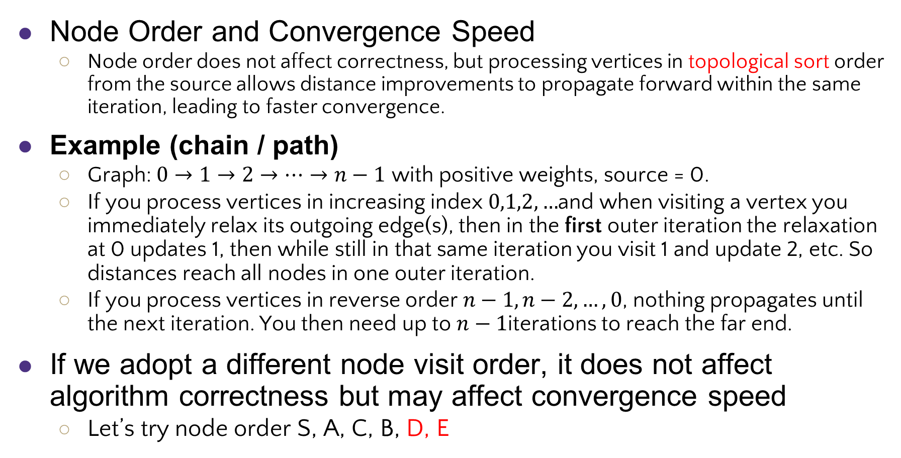
Bellman-Ford Convergence Speed
Node Order and Convergence Speed
Node order does not affect correctness, but processing vertices in topological sort order from the source allows distance improvements to propagate forward within the same iteration, leading to faster convergence.
Example (chain / path)
Graph: $0→1→2→⋯→n−1$ with positive weights, source = 0.
If you process vertices in increasing index $0,1,2,…$and when visiting a vertex you immediately relax its outgoing edge(s), then in the first outer iteration the relaxation at 0 updates 1, then while still in that same iteration you visit 1 and update 2, etc. So distances reach all nodes in one outer iteration.
If you process vertices in reverse order $n−1,n−2,…,0$, nothing propagates until the next iteration. You then need up to $n−1$iterations to reach the far end.
If we adopt a different node visit order, it does not affect algorithm correctness but may affect convergence speed
Let’s try node order S, A, C, B, D, E
Notes:
Node order does not affect Bellman–Ford correctness, but a forward/topological or distance-increasing processing order can make improvements propagate within the same iteration and thus often speed up convergence in practice — though the theoretical worst-case remains $V−1$iterations.
Recommendation:
Relax vertices in outward (level-by-level) order from the source when possible.
Node order matters for intra-iteration propagation; updates are visible later in the same pass
If we adopt a different node visit order, it does not affect algorithm correctness but may affect convergence speed
A good heuristic to speed convergence in practice: relax edges (or nodes) following a breadth-first/topological-like order outward from the source so improvements propagate forward within the same pass.
Theoretical Guarantee (Worst Case)
Bellman–Ford guarantees correctness after |V| − 1 iterations. Here |V| = 6 → maximum required = 5 iterations. This is an upper bound, not a required minimum.
Early Stop Rule
If an iteration produces no updates, the algorithm can safely terminate early. That is what happens in Iteration 3.
: Bellman-Ford will still converge, but slower, e.g., node D’s update cannot propagate to C in the same iteration.
We assumed node visit order S, A, C, B, E, D in this example.
The algorithm remains correct,
But convergence speed will be slower.
Copy table from p48 to illustrate, Need 2 iterations to reach that table with one iteration.
Different relaxation orders may require more iterations to converge. Bellman–Ford guarantees correctness after V − 1 full passes regardless of order.

Slide 50
Bellman-Ford Example
0
10
∞
1
∞
start
S
A
B
8
2
∞
-4
-2
E
node | SD | PN
S | 0
A | ∞
B | ∞
C | ∞
D | ∞
E | ∞
1
∞
∞
-1
C
D
We assume node visit order S, A, C, B, D, E in this example.
Notes:
We visit nodes in this order in each iteration: S, A, B, C, D, E

Slide 51
Bellman-Ford Example
0
10
10
1
10
start
S
A
B
8
Iteration 1
2
8
-4
-2
E
node | SD | PN
S | 0 | -
A | 10 | S
B | 10 | C
C | 12 | A
D | 9 | E
E | 8 | S
1
12
9
-1
C
* D cannot use its SD of 9 to relax A and C until the next iteration
D
We assume node visit order S, A, C, B, D, E in this example.
Notes:
* Because a distance to D is known by the time we process D we can include D’s outgoing edges for consideration

Slide 52
Bellman-Ford Example
0
10
5
1
10
start
S
A
B
8
Iteration 2
2
8
-4
-2
E
node | SD | PN
S | 0 | -
A | 10, 5 | S, D
B | 10, 6 | C
C | 12, 8 | A, D
D | 9 | E
E | 8 | S
1
8
9
-1
C
* Same as Iteration 1 before
D
We assume node visit order S, A, C, B, D, E in this example.
Notes:
TODO This slide implies that C is visited before D. Should I give a fixed visit order?

Slide 53
Bellman-Ford Example
0
10
5
1
5
start
S
A
B
8
Iteration 3
2
8
-4
-2
E
node | SD | PN
S | 0 | -
A | 5 | D
B | 6, 5 | C
C | 8, 7 | D, A
D | 9 | E
E | 8 | S
1
7
9
-1
C
* Same as Iteration 2 before
D
We assume node visit order S, A, C, B, D, E in this example.
Notes:
We assumed node visit order S, A, C, B, E, D in this Bellman-Ford example. (Even this is incorrect.)
If we adopt a different node visit order of S, A, B, C, D, E, how will it affect algorithm correctness, and convergence speed?
ANS: It does not affect algorithm correctness, but affects convergence speed. Bellman-Ford will still converge, but slower.

Slide 54
Bellman-Ford Example
0
10
5
1
5
start
S
A
B
8
Iteration 4
2
8
-4
-2
E
node | SD | PN
S | 0 | -
A | 5 | D
B | 5 | C
C | 7 | A
D | 9 | E
E | 8 | S
No changes!
This means we can stop early
1
7
9
-1
C
D
We assume node visit order S, A, C, B, D, E in this example.
Notes:
We assumed node visit order S, A, C, B, E, D in this Bellman-Ford example. (Even this is incorrect.)
If we adopt a different node visit order of S, A, B, C, D, E, how will it affect algorithm correctness, and convergence speed?
ANS: It does not affect algorithm correctness, but affects convergence speed. Bellman-Ford will still converge, but slower.

Slide 55

Bellman-Ford Example II
v SD[]
0
1
2
3
4
5
6
7
$$∞$$
$∞$ $∞$
$$∞$$
$$∞$$
$$∞$$
$$∞$$
$$∞$$
0
5
17
20
9
13
28
8
14
17
26
25
1
15
3
5
4
12
0
3
8
7
2
7
9
v PN[]
9
5
6
1
0
1
2
3
4
5
6
7
-
-
-
-
-
-
-
-
0
1
1
0
4
2
0
5
2
5
2
5
11
4
4
13
20
6
Iter 1
Iter 2
Iter 3
(converged, no further changes, so stop here)
We assume node visit order 0, 1, 2, 3, 4, 5, 6, 7 in this example.
Reverse order of edge relaxations will result in slower convergence, but does not affect correctness
Notes:
Repeat V − 1 times: relax all E edges.

Slide 56
A Toy Example with Negative Edge Weights
Let’s run Dijkstra’s algorithm, Topological Sort, and Bellman Ford Algorithm on this DAG with a negative edge weight
B
10
-20
A
D
1
E
1
1
C

Slide 57
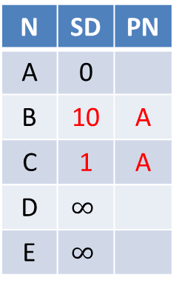
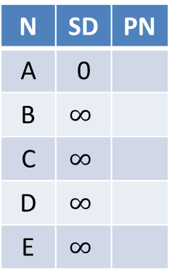
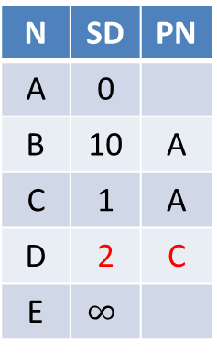
Dijkstra’s algorithm does not work for a graph w/ negative edge weights
N | SD | PN
A | 0
B | $$∞$$
C | $$∞$$
D | $$∞$$
E | $$∞$$
N | SD | PN
A | 0
B | 10 | A
C | 1 | A
D | $$∞$$
E | $$∞$$
N | SD | PN
A | 0
B | 10 | A
C | 1 | A
D | 2 | C
E | $$∞$$
N | SD | PN
A | 0
B | 10 | A
C | 1 | A
D | 2 | C
E | 3 | D
Visit A
Visit C
Visit D
Visit E
B
N | SD | PN
A | 0
B | 10 | A
C | 1 | A
D | 2 | C
E | 3 | D
N | SD | PN
A | 0
B | 10 | A
C | 1 | A
D | -10 | B
E | 3 | D
10
-20
Visit E
Visit B
A
D
1
E
1
1
Since Dijkstra’s algorithm is a greedy algorithm that always closest unknown node (with the smallest SD), node B with SD of 10 is visited last, so node E’s final SD of 3 is incorrect.
C

Slide 58
Dijkstra’s algorithm does not work for a graph w/ negative edge weights
Dijkstra’s Algorithm is greedy: each node is visited once, and any node that has been visited should have its shortest distance from the source.
After visiting A, C, D, E, we have computed D’s SD is 2, but after visiting B, D’s SD is updated to -10, which violates the greedy optimal assumption.
Even if we update D’s SD to be -10, its downstream node E’s SD will not be updated.
We cannot visit B before D, since we must visit the closest unknown node (with smallest SD), which is D. (Unlike topological sort, which visits B before D and gets the correct result,)

Slide 59
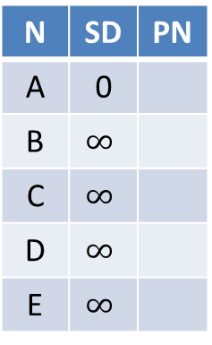
Bellman Ford works for a graph with negative edge weights
N | SD | PN
A | 0
B | $$∞$$
C | $$∞$$
D | $$∞$$
E | $$∞$$
N | SD | PN
A | 0
B | 10 | A
C | 1 | A
D | -10 | B
E | -9 | D
N | SD | PN
A | 0
B | 10 | A
C | 1 | A
D | -10 | B
E | -9 | D
Iter 1
Iter 2
No change
converged
B
Suppose we visit nodes in this order at each iteration: A, B, C, D, E. We run for 2 iterations (less than V-1=3 iterations), and converge to the correct SPT
10
-20
A
D
1
E
1
1
C
Notes:
There are no negative weight cycles.
obtained shortest paths from node A to all other nodes.
The shortest path from A to D is ABD with cost of -10

Slide 60
Dijkstra's Algorithm vs. Bellman-Ford Algorithm
Dijkstra's Algorithm:
Uses a priority queue to select the next node to process.
Greedily selects the node with the smallest tentative distance to source node.
Works only on graphs with non-negative edge weights.
Bellman-Ford Algorithm:
Iteratively relaxes all edges V-1 times.
Can handle graphs with negative edge weights, and can detect negative cycles.
Relax all the edges one more time, i.e. the V-th time. Negative cycle exists if any edge can be further relaxed
It can find any negative cycle that is reachable from source node s (but not negative cycles that are unreachable from s).
If there is a negative cycle that is reachable from source node s, then any paths that go through the cycle has distance −∞, since the cost can be reduced by traversing the cycle infinite number of times.
Dijkstra's algorithm is faster and more efficient for graphs with non-negative weights; Bellman-Ford Algorithm is more versatile as it can handle negative weights and detect negative cycles, albeit at the cost of lower efficiency
Notes:
Does not use a priority queue.
If you can keep looping and reduce cost, no minimum exists.
When a node u is marked known, SD[u] equals the true shortest path distance

Slide 61
Single Source Shortest-paths Algorithms Summary
Algorithm | Applicability | Worst-Case Complexity
Breadth First Search (BFS) | Unweighted, undirected or directed graph | Adjacency List: O(V + E) Adjacency Matrix: O(V²)
Dijkstra’s algorithm | Undirected or directed graph; no negative weights/cycles | O((V+E) log V) (binary min-heap)
Bellman-Ford algorithm | Directed graph with negative weights; undirected graph with no negative weights (since a negative weight edge forms a negative cycle by itself) | O(VE)
61
Notes:
Adjacency List: O(V + E)
Each node is processed exactly once: O(V)
Each edge is examined exactly once: O(E)
Total complexity: O(V + E)
Efficient for sparse graphs (where E is much less than V²)
Using Adjacency Matrix: O(V²)
worst case O(VlogV+E)
Remark 1. Directed cycles make the problem harder.
Remark 2. Negative weights make the problem harder.
Remark 3. Negative cycles makes the problem ill-defined.
E+V
E+V
Dijkstra (binary heap)
E log V
E log V
Bellman-Ford
EV
EV

Slide 62
Distance Vector vs. Link State Routing
Parameter | Distance Vector Routing | Link State Routing
Routing Information | Routers share their routing tables with their neighbors. | Routers share information about the entire network topology.
Convergence | Slower convergence. | Faster convergence.
Updates | Periodic updates are sent to neighboring routers. | Updates are triggered by changes in the network topology.
Algorithm | Uses the Bellman-Ford algorithm. | Uses Dijkstra’s algorithm.

Slide 63
References
Dijkstras Shortest Path Algorithm Explained | With Example | Graph Theory
https://www.youtube.com/watch?v=bZkzH5x0SKU
Dijkstra's algorithm in 3 minutes
https://www.youtube.com/watch?v=_lHSawdgXpI
Bellman-Ford, Michael Sambol
https://www.youtube.com/watch?v=9PHkk0UavIM
https://www.youtube.com/watch?v=obWXjtg0L64
Bellman Ford Shortest Path Algorithm, ByteQuest
https://www.youtube.com/watch?v=B5PmlJACZ9Y
Shortest Path Algorithms Explained (Dijkstra's & Bellman-Ford), b001
https://www.youtube.com/watch?v=TtQi1LVVOUI
[CSE 373 WI24] Lecture 15: Shortest Path
https://www.youtube.com/watch?v=L8nhMwhUn4U&list=PLEcoVsAaONjd5n69K84sSmAuvTrTQT_Nl&index=14
Notes:
Geeksforgeeks topological sort
https://www.geeksforgeeks.org/topological-sorting-indegree-based-solution/
Bellman Ford Algorithm Explained
Basics Strong
Bellman-Ford Shortest Path Algorithm Visually Explained
ByteVigor
Johnson's Algorithm| All pair shortest path algorithm| Harshit jain[NITA]
Harshit jain https://www.youtube.com/watch?v=wCjEP8TYi-E

